Slide 1
DIGITAL PORTFOLIO
STUDENT NAME : Venisha V
REGISTER NO AND NMID : 24131210500122049/
asanm121anm12124213048
DEPARTMENT : BCA
COLLEGE : Immaculate college for women
UNIVERSITY : Annamalai University

Slide 2

PROJECT TITLE
Student Portfolio

Slide 3
AGENDA
Problem Statement
Project Overview
End User
Tools and Technologies
Portfolio design and Layout
Features and Functionality
Results and Screenshots
Conclusion
GitHub link

Slide 4

PROBLEM STATEMENT
This project addresses that problem by creating a personal portfolio website using HTML, CSS, and JavaScript, offering a modern, responsive, and user-friendly platform to details
In today’s competitive digital era, professionals such as developers, designers, and creators often struggle to present their skills, experiences, and projects in a way that is both professional and easily accessible.isplay skills, projects, and contact details.

Slide 5

PROJECT OVERVIEW
This project is a personal portfolio website designed and developed using HTML, CSS, and JavaScript.
The portfolio provides a clean, responsive, and visually appealing platform to showcase personal details, skills, and completed projects.
It consists of key sections such as About Me, Projects, and Contact, along with interactive features like smooth scrolling, a mobile-friendly hamburger menu, and a back-to-top button.

Slide 6

END USER
Recruiters and Hiring Managers → To review skills, projects, and contact details during job applications. Clients and Organizations → To evaluate capabilities before offering freelance or project-based work. Peers and Collaborators → To explore skills and projects for potential collaboration. General Audience → Anyone interested in learning more about the developer’s work and expertise.

Slide 7

TOOLS AND TECHNOLOGIES
HTML5 → Provides the structure and content of the portfolio website. CSS3 → Used for styling, layout, responsiveness, and visual design. JavaScript (ES6) → Adds interactivity (smooth scrolling, hamburger menu, back-to-top button).
Git & GitHub → Version control and hosting the portfolio online. PowerPoint → Used to document and present the project.

Slide 8

PORTFOLIO DESIGN AND LAYOUT
Header Section → Contains the portfolio title (name), tagline, and navigation menu. Navigation Bar → Links to key sections (About, Projects, Contact) with smooth scrolling. About Section → Includes a centered circular profile picture and a short introduction. Projects Section → Displays project cards with titles, descriptions, and clean layouts. Contact Section → Provides email and LinkedIn for professional communication. Responsive Layout → Adapts to desktop and mobile devices with a hamburger menu for small screens.

Slide 9

FEATURES AND FUNCTIONALITY
Responsive Design → Works seamlessly on desktop, tablet, and mobile devices. Smooth Scrolling → Navigation links allow users to move between sections with smooth transitions. Circular Profile Image → Centered profile picture styled with CSS for a modern look. Project Showcase → Dedicated section to highlight projects with titles and descriptions.

Slide 10
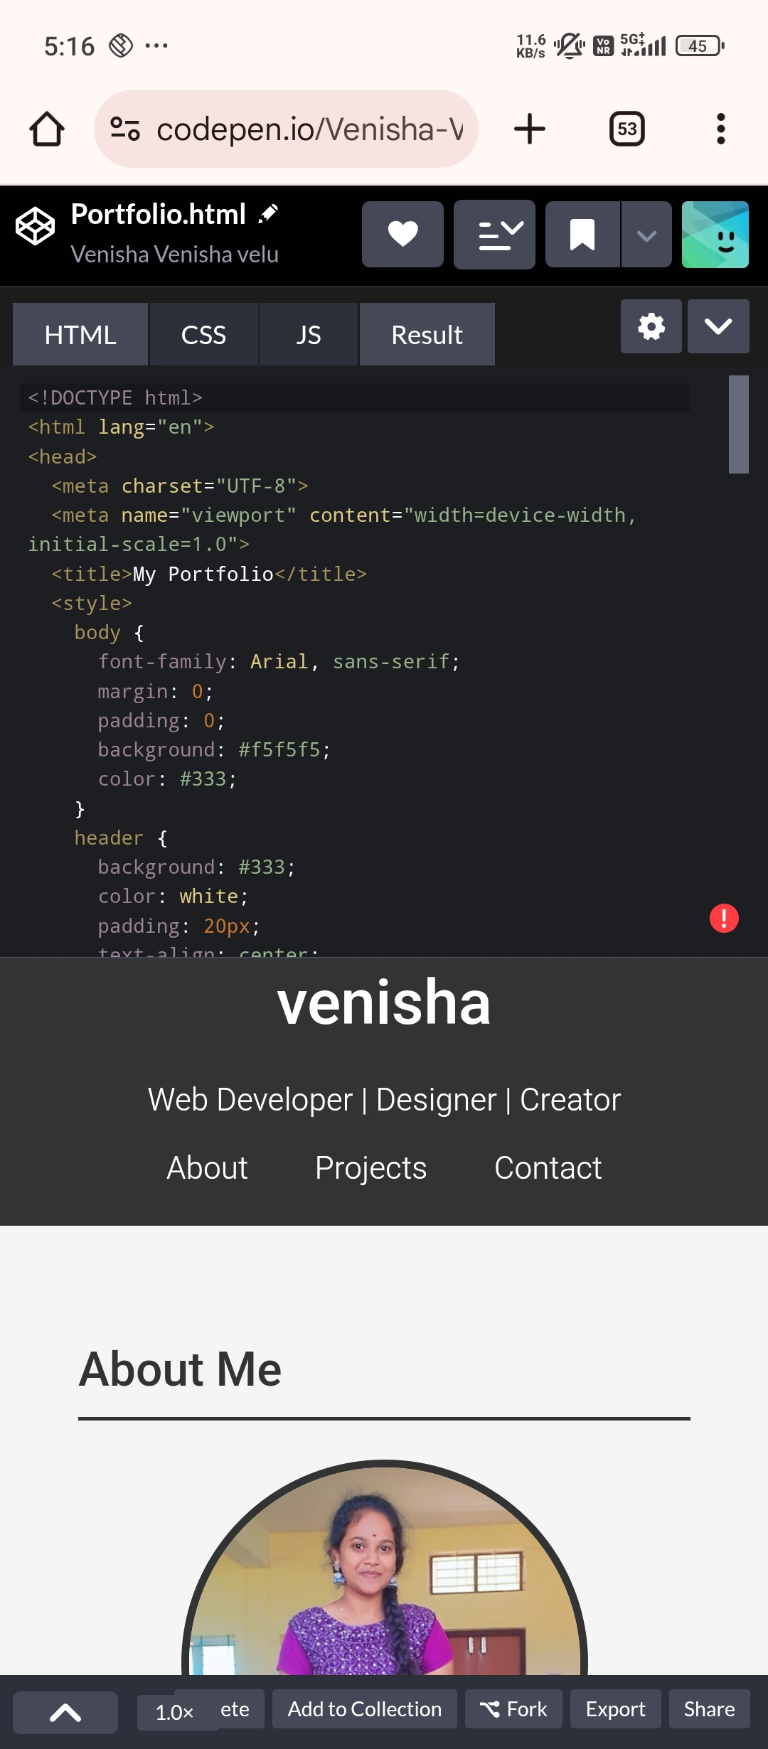
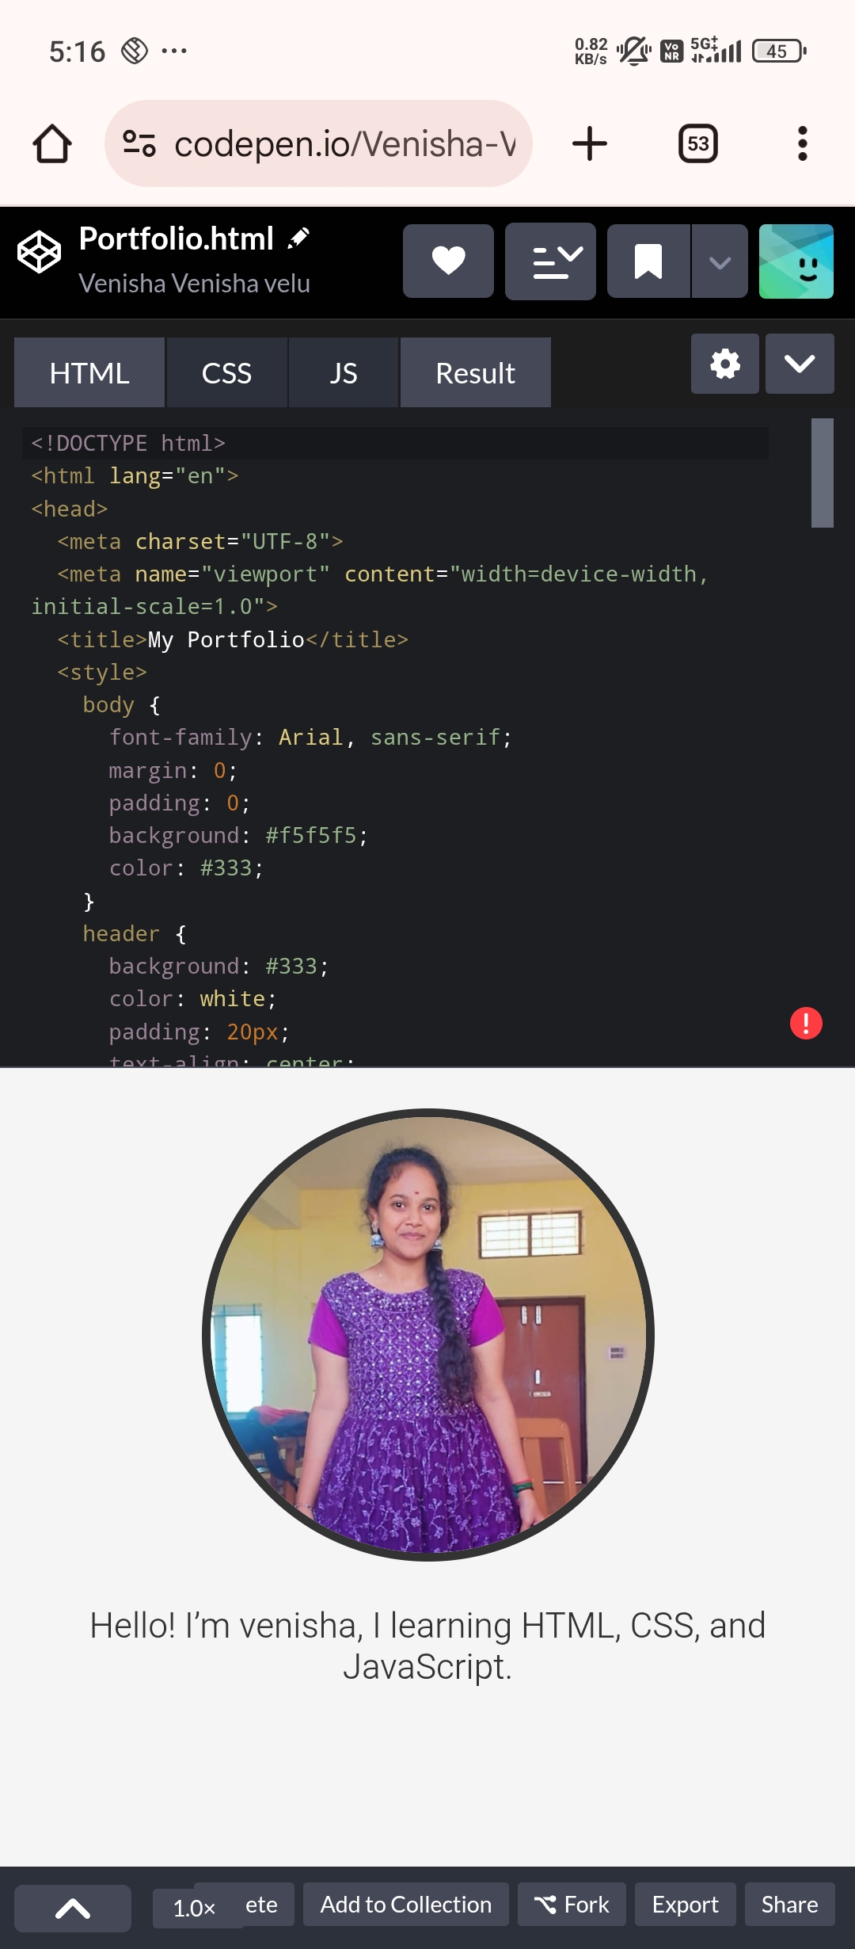
RESULTS AND SCREENSHOTS

Slide 11
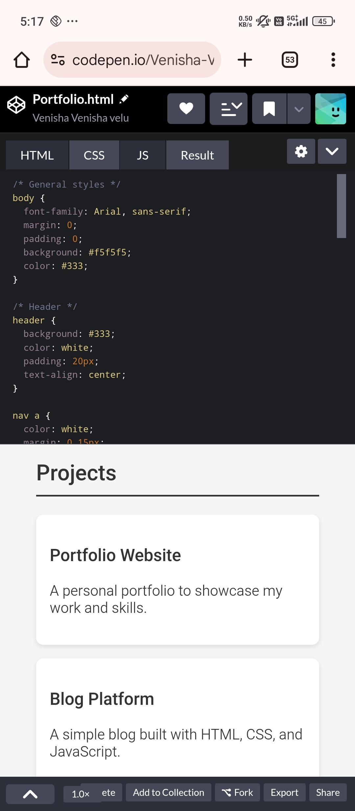
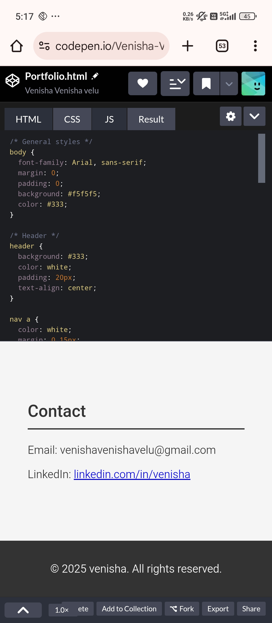
RESULTS AND SCREENSHOT

Slide 12

CONCLUSION
The portfolio website successfully demonstrates the use of HTML, CSS, and JavaScript to build a clean, responsive, and interactive personal website. It provides an effective platform to showcase skills, projects, and contact details in a professional way.

Slide 13

GITHUB LINK
https://venishavenishavelu-beep.github.io/Venisha-TNSDC-FWD-DP/

